Slide 1
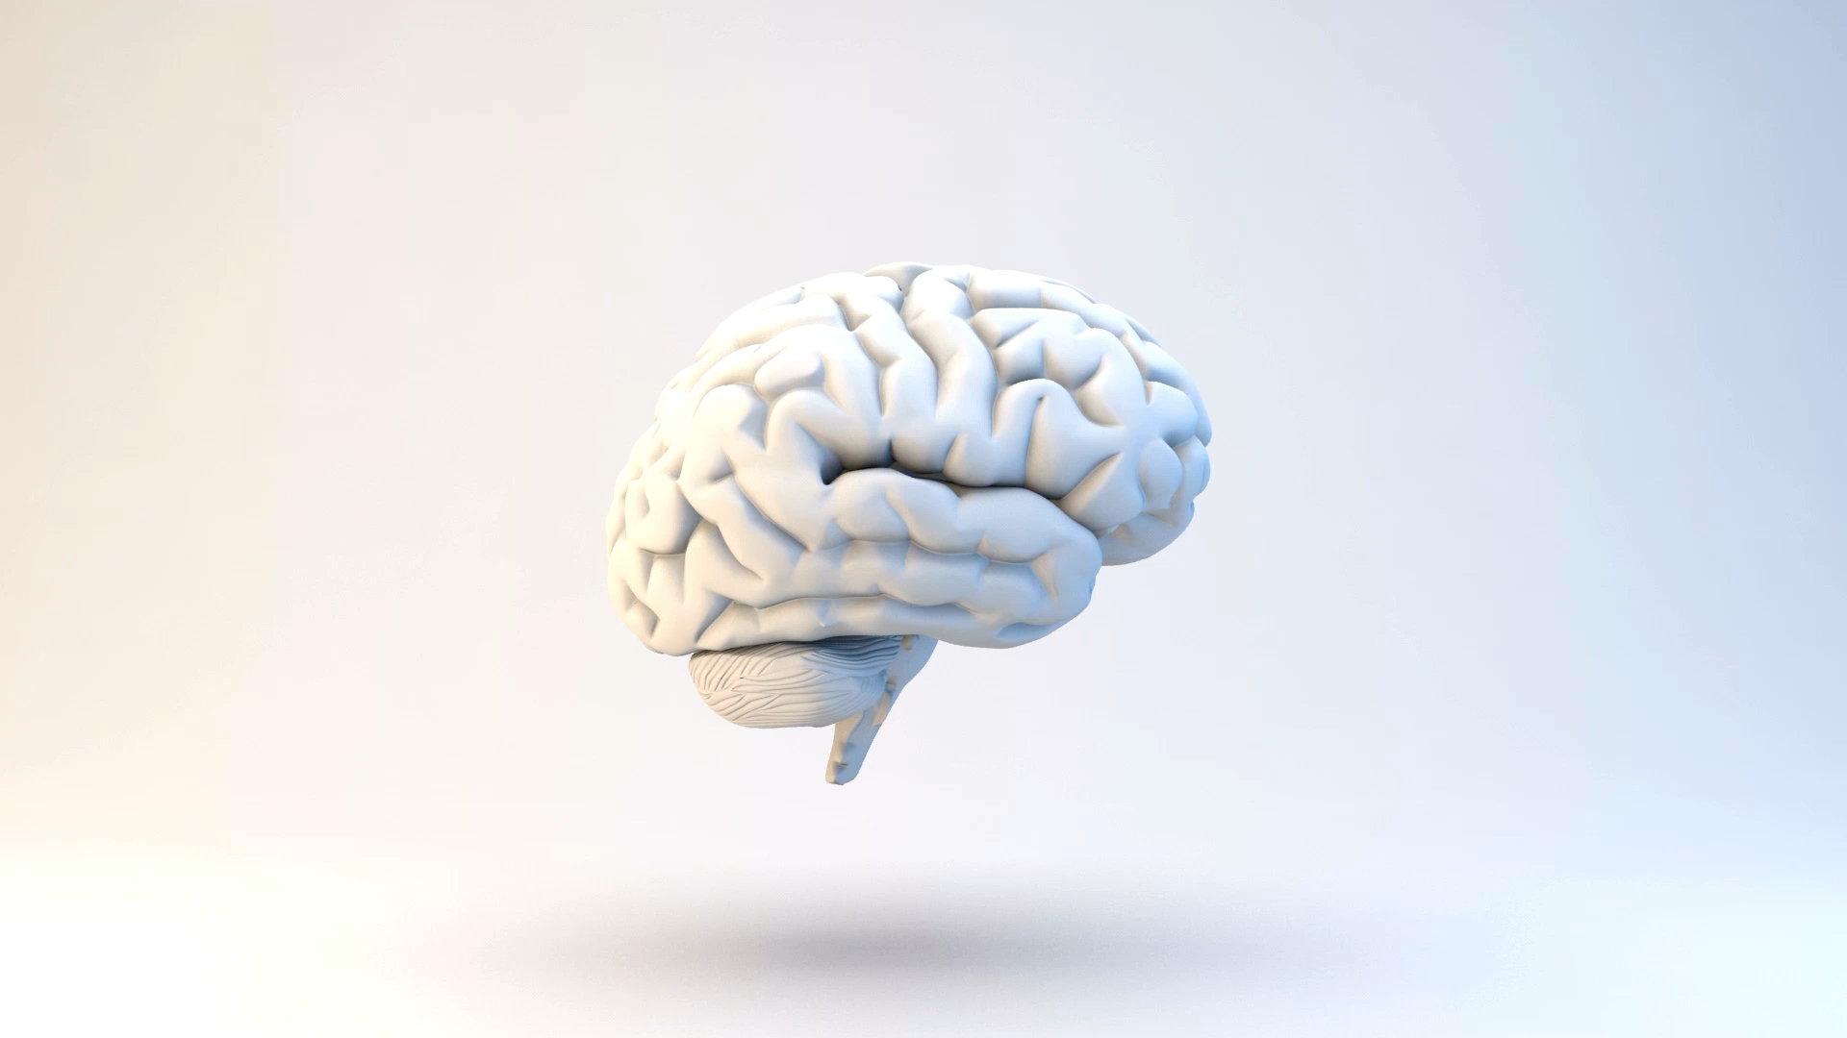
What is Artificial Intelligence (AI)
Kindergarten – Year 2

Slide 2
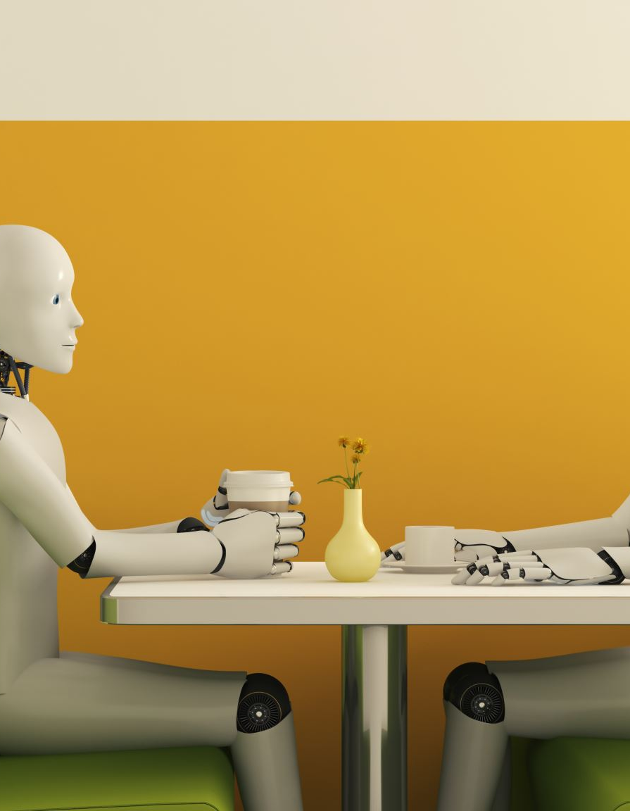
What does artificial mean?
Artificial means something that people make instead of it growing or happening on its own.
Example: The table and chairs around us did not occur naturally and were made and constructed by humans.

Slide 3
Artificial vs Natural
Worksheet: Label the images as either artificial or natural

Slide 4
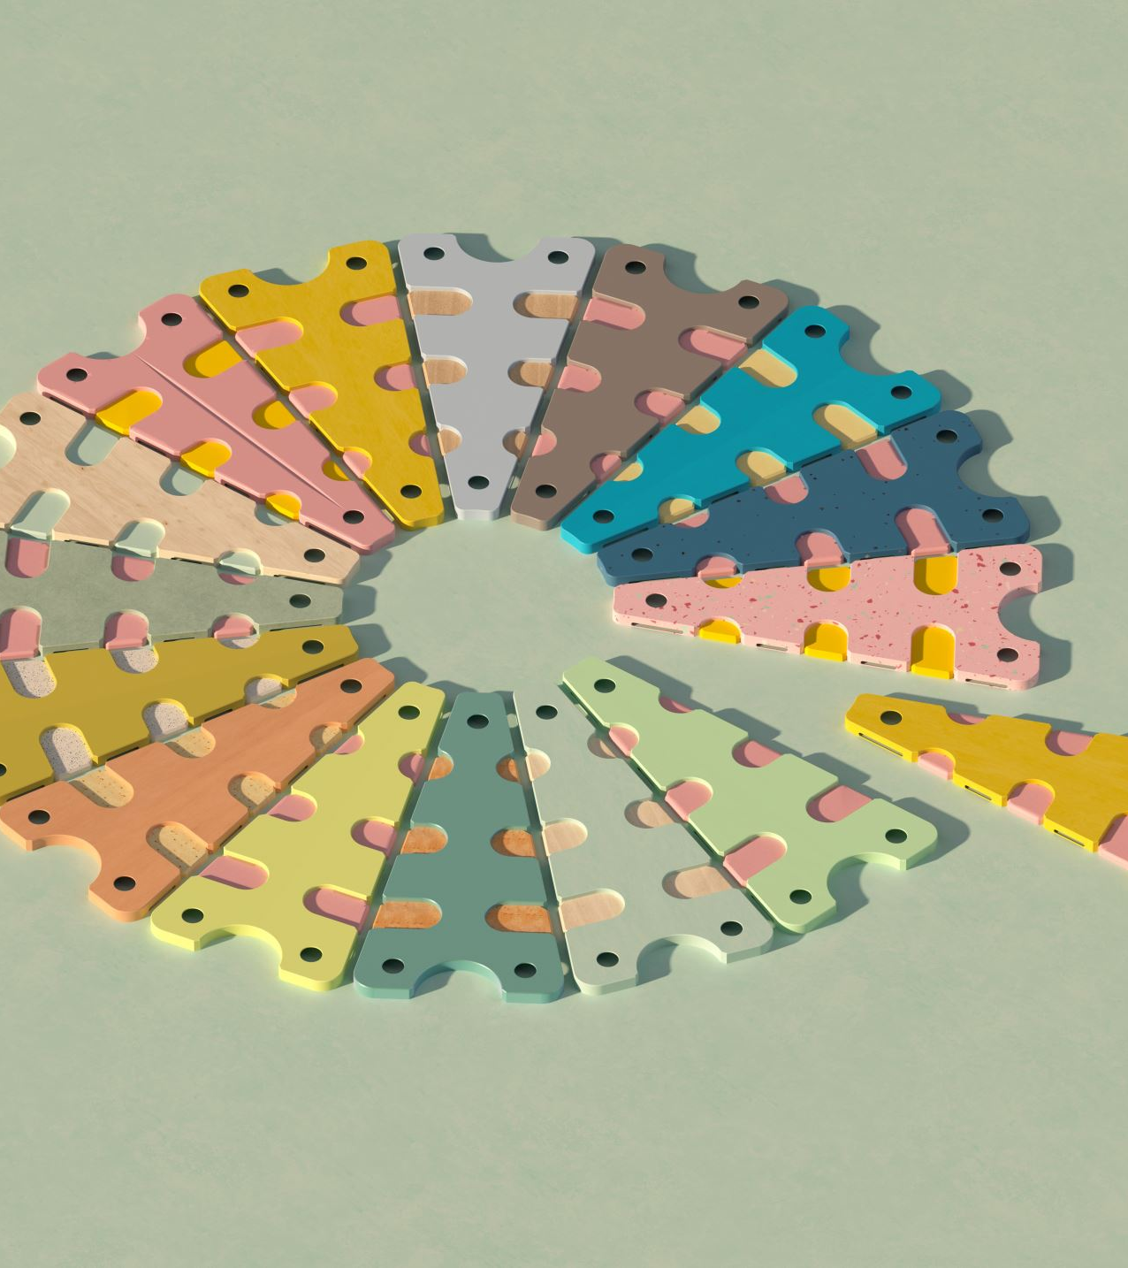
What does it mean to be Intelligent?
Being able to learn new things, solve puzzles, recognise patterns and understand the world around us
We train our brains by practising things like talking, reading, solving puzzles, or even playing.

Slide 5
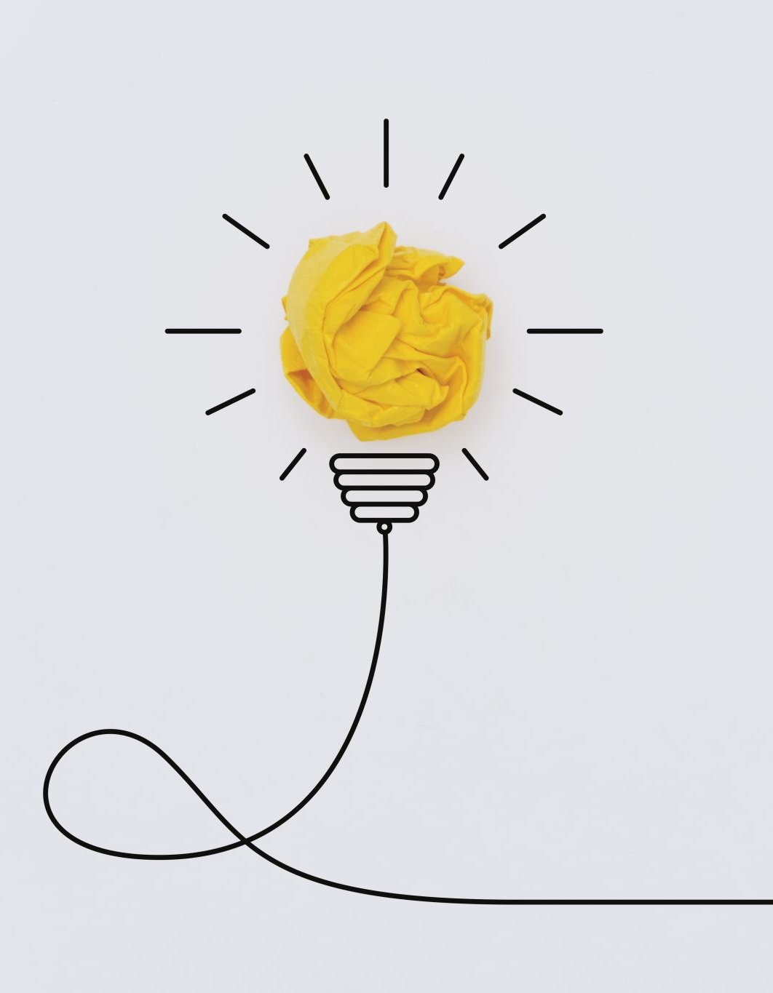
Brainstorm
Brainstorm examples of AI you may use in your everyday lives

Slide 6
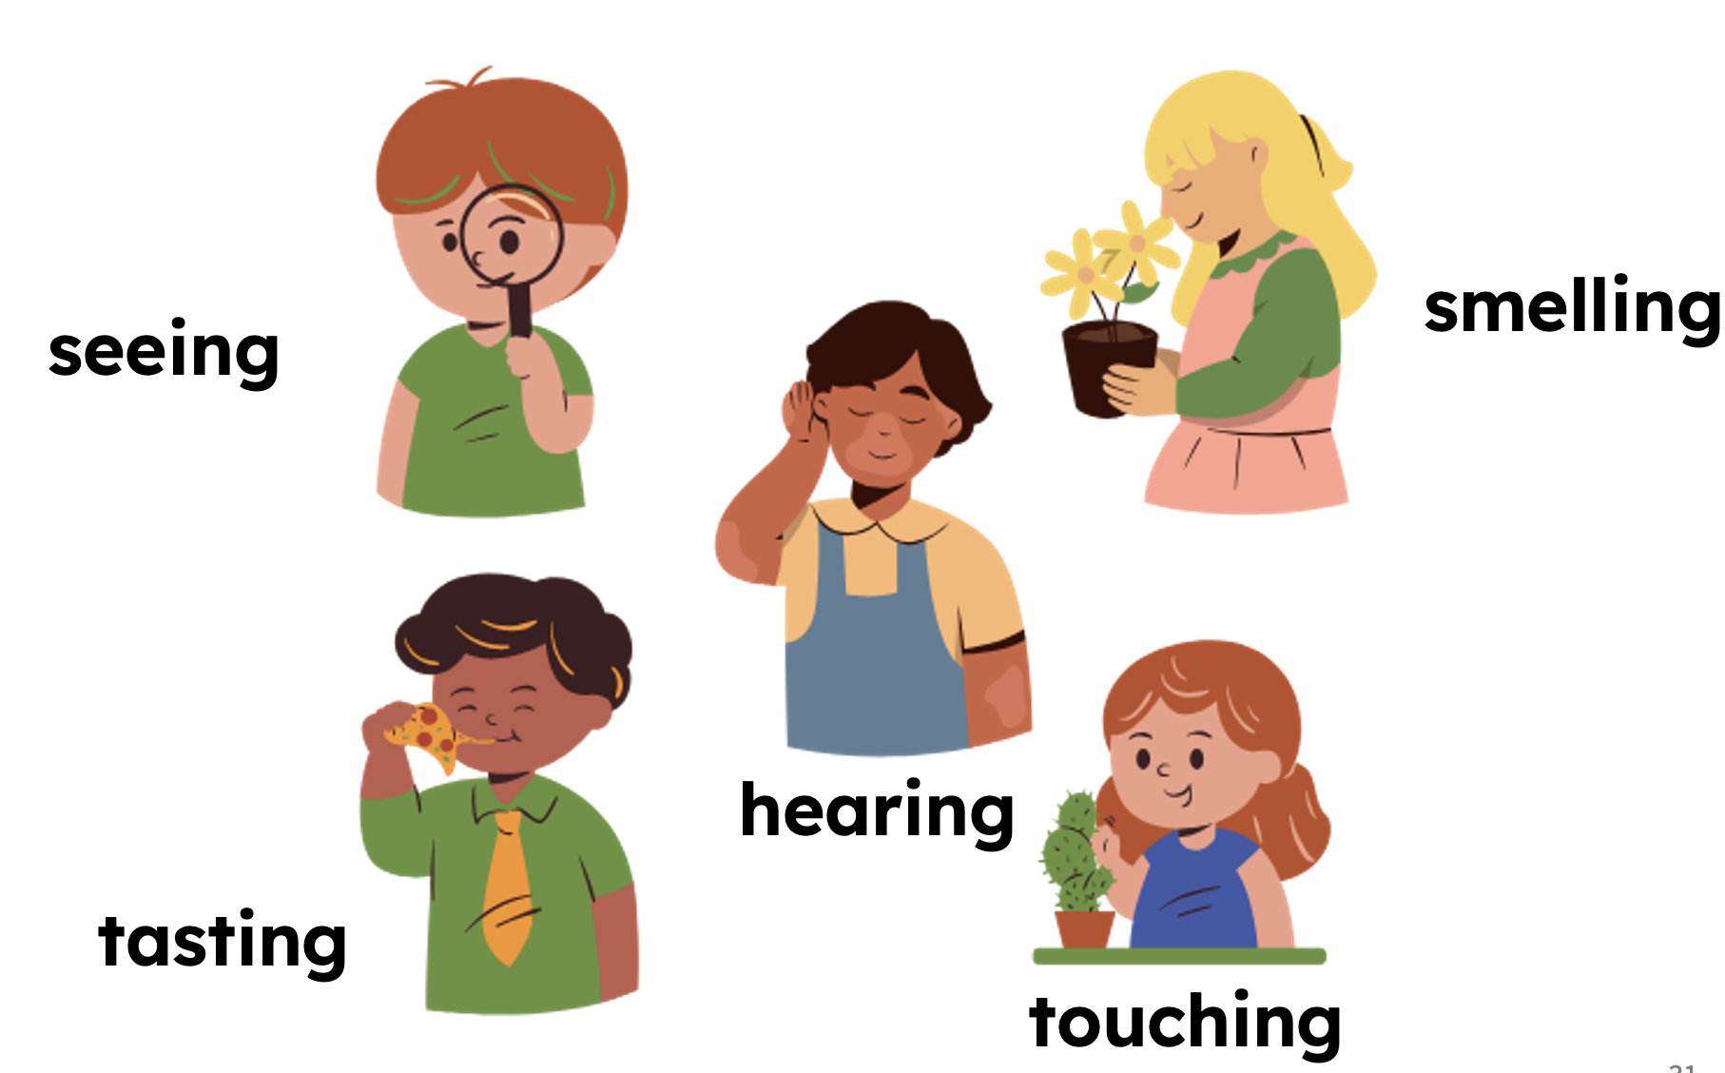
We learn using our 5 senses

Slide 7
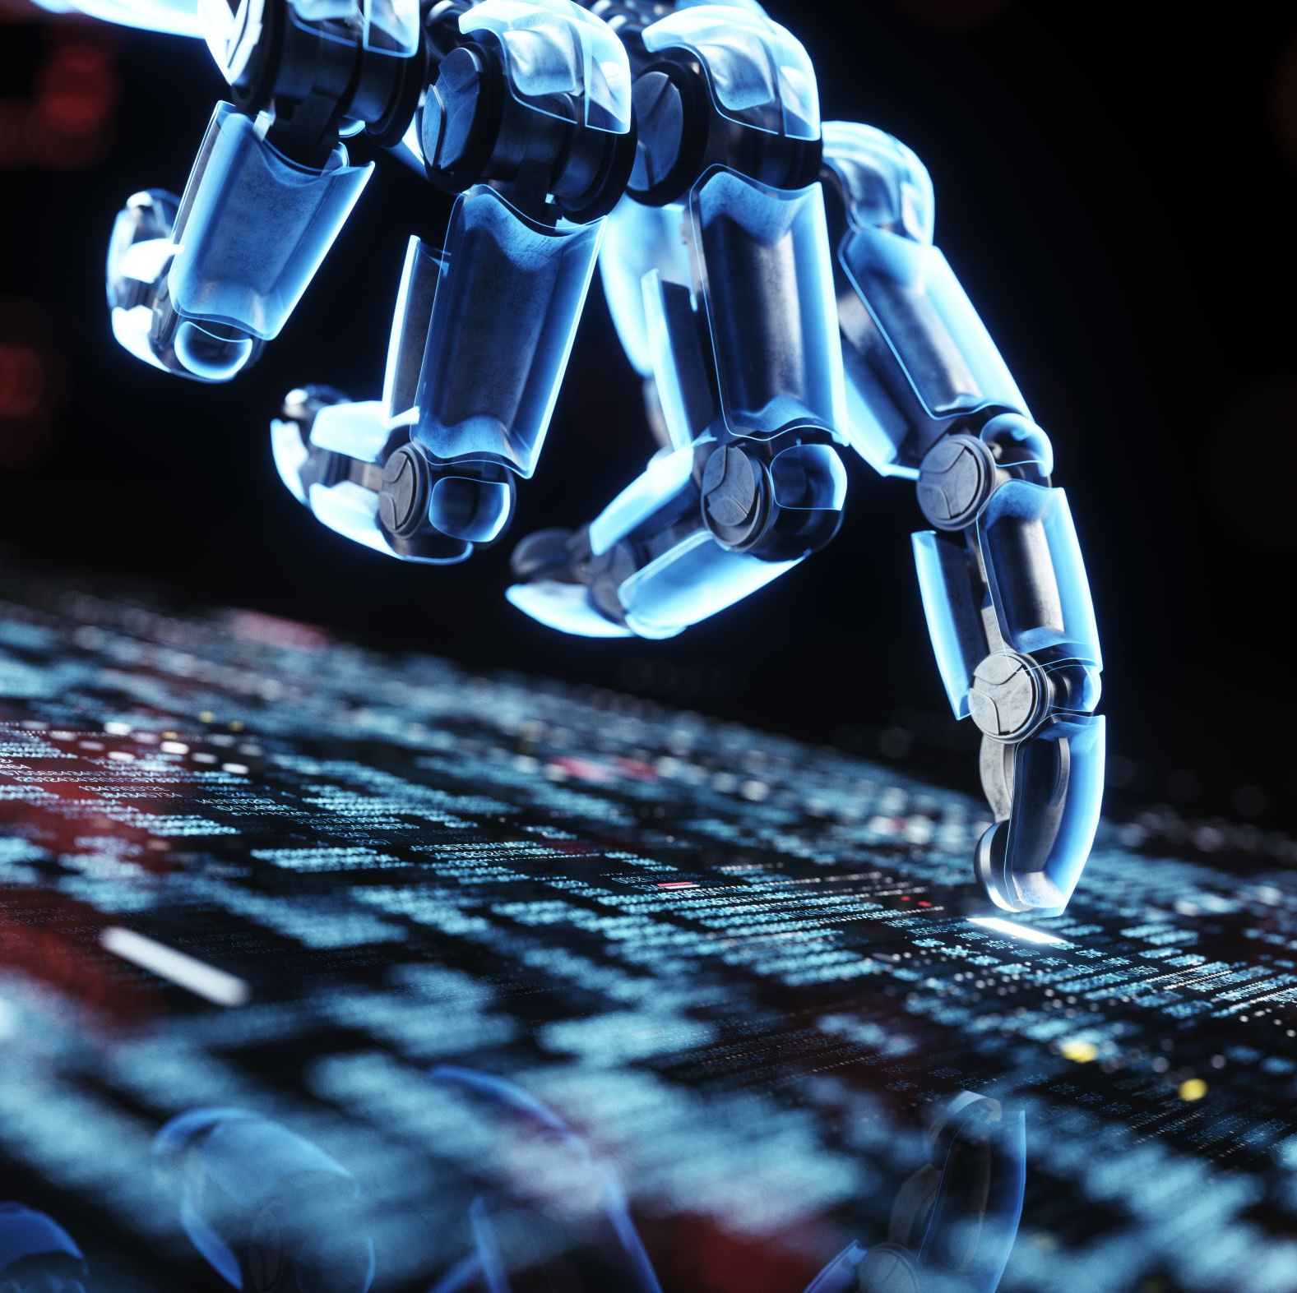
How do machines learn?
AI uses information and data to make decisions and learn
It can get this information from sensors, human input, or by accessing the information online

Slide 8

Questions?

